Slide 1
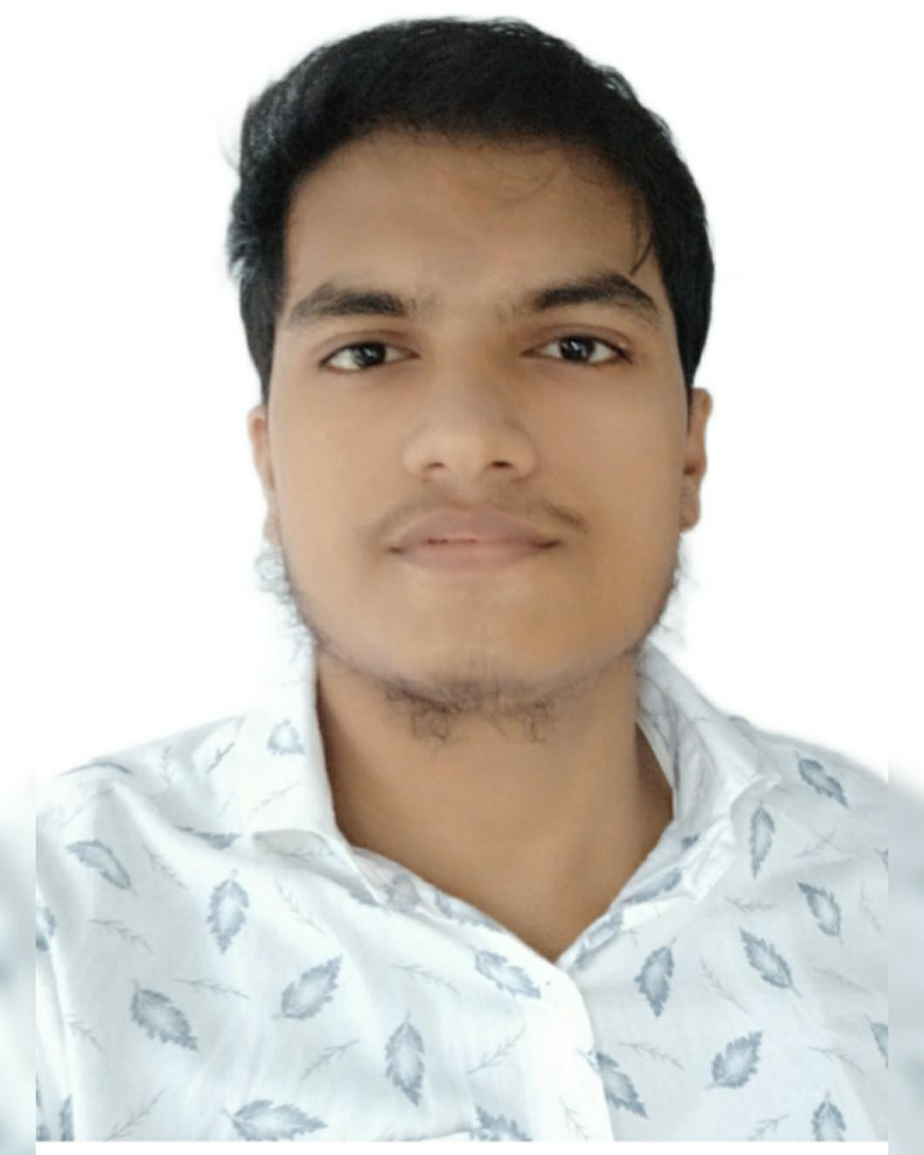

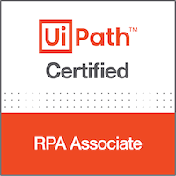


Industry and Project Experience
Sudhanshu Bhagat
RPA Software Engineer
Data Extraction from Health insurance claim form (UiPath)(Client Medrisk)- The process involves utilizing Intelligent Document Processing (IDP) to extract 140 data fields from documents supplied by a medical insurance company. These fields include details about medical illnesses, costs associated with specific ailments, such as name, address, date, referred doctor, and total bill. This streamlined extraction process enhances efficiency in managing medical insurance data, ensuring accurate and comprehensive information retrieval.. PBIRS process(same client Medrisk):- The PBIRS process automates timecard management for client employees, specifically focusing on marking lunch and snacks break times. It identifies employees who exceed a specific lunch or snacks break duration and ensures breaks do not surpass a predefined time limit. This streamlines timekeeping processes, ensuring compliance and efficiency in managing employee schedules. This process was completly based on Excel automation and we need to work on excel formula also.. Uipath HyperHack 2023-Participated in Uipath HyperHack 2023, as team named Robotknights, The project integrated UiPath with ChatGPT to facilitate a conversational platform for medical inquiries. Medical diagnosis documents were digitized, primarily focusing on prescriptions and illness names. Users could inquire about medical concerns, and GPT would respond with relevant information sourced from the Excel Database , aiding in medical guidance and assistance. Resource Management(Uipath)- Worked on Automating Utilisation Report of Talent Management team , in which bot will analyze previous utilization report and current day report , It will send the change details in Utilization report to respective managers of the respective employees
Invoice extraction(UiPath)-In this poc we have to go rpachallengeocr website and extract ,ID and Due date and download the invoice and From the invoices, we have to extract the Invoice Number, Invoice Date, Company Name and Total Due. I have used document understanding for data extraction
Unstructured Email Extraction(UiPath)-we have to extract data from unstructured email on outlook ,this I have done using regular expression as our data was unstructured.
Linkedin extraction(UiPath)-In this we have Given a list of names ,we have to go to linkedin and login and searching these candidates and step by step we have to extract Company Name ,Job Title ,Location ,Designation and save it to Excel File.
Nse Extraction(UiPath) – In this poc we have to go nse website and go to nifty 50 and for top 10 stocks of nifty 50 we have to extract total market cap,current price,52week low,52week high and respective dates and save it to excel then on next part we have to generate a form and get buy/sell and Quantity as input. I have contributed numerous solution as part of large-scale project.
Professional Background
2 Years full time and 6 Months Internship of experience At Persistent System in RPA + Document Understanding.
UiPath Certified RPA Developer. Worked for Medrisk Client. Participated in Thermofisher Hackathon 2024. Participated in Uipath Hyperhack 2023, . Participated in Intelligent Business Automation Hackathon 2023 OutSystem Reactive Developer Certified
Implemented 20+ process automation yielding benefit to the organization.
Involved in RPA end to end process automation from gathering requirements and Developing the code for the User.
Experience in error handling and debugging the processes.
Worked in various domains and various teams and can work flexibly.
Experience in automating Data extraction using Document Understanding Using ML Extractor , Excel automations etc,.
Relevant Experience
Experienced in Developing Code for Automation and Documentation.
Designed and developed solutions in accordance with standard design principles and conventions and development best practice.(UiPath)
Managed and mentored Resources who are upskilling into UiPath
Well versed with UiPath Document Understanding, AI Center capabilities|.
Technical Skills
Education and Certifications
Primary Skill – Robotic Process Automation,AI CENTER ,Excel Formula
Other Skill: Structured Query language (SQL),GIT, Data structures and Algorithm,C#,C++
Operating Systems: Windows
B.Tech in INFORMATION TECHNOLOGY from kolkata, India
UiPath_RPA_Associate_Certified
Outsystem Reactive Developer certified
Uipath Developer Foundation Diploma and Document Understanding from Uipath Academy

